Slide 1





E-COMMERCE SALES
“NAVIGATING THE FUTURE OF ONLINE SHOPPING USING SQL”
BY - VANSHIKA MAHAJAN

Slide 2

TABLE OF CONTENT
1
CUSTOMERS BY STATE
6
AVERAGE DELIVERY TIME
ORDER STATUS COUNT
MONTHLY ORDER COUNT
2
7
UNIQUE PRODUCTS SOLD
TOP ORDERING CUSTOMER
3
8
4
PRODUCTS BY CATEGORY
9
CANCELLATION RATE BY CATEGORY
5
TOP STATES BY CUSTOMERS
1
0
ON-TIME VS DELAYED

Slide 3





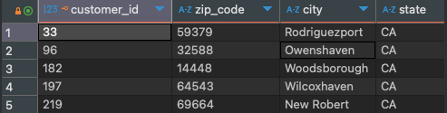
LIST ALL CUSTOMERS FROM A PARTICULAR STATE.

Slide 4



2. COUNT THE NUMBER OF ORDERS BY THEIR STATUS.

Slide 5
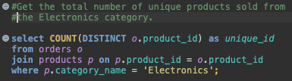

3. GET THE TOTAL NUMBER OF UNIQUE PRODUCTS SOLD.

Slide 6



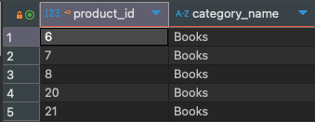
4. RETRIEVE ALL PRODUCTS IN A SPECIFIC CATEGORY.

Slide 7
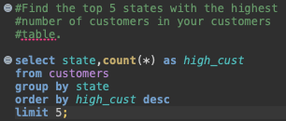

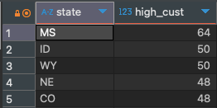
5. FIND THE TOP 5 STATES WITH THE HIGHEST NUMBER OF CUSTOMERS.

Slide 8


6. CALCULATE THE AVERAGE DELIVERY TIME FOR ALL DELIVERED ORDERS.

Slide 9

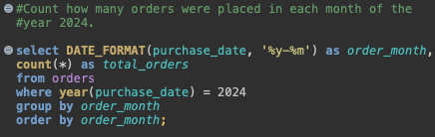
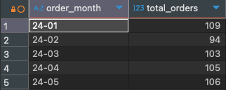
7. COUNT HOW MANY ORDERS WERE PLACED EACH MONTH.

Slide 10
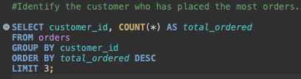

8. IDENTIFY THE CUSTOMER WHO HAS PLACED THE MOST ORDERS.

Slide 11
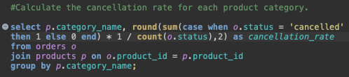
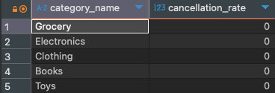
9. CALCULATE THE CANCELLATION RATE FOR EACH PRODUCT CATEGORY.

Slide 12
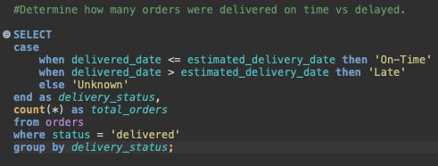

10. DETERMINE HOW MANY ORDERS WERE DELIVERED ON TIME VS DELAYED.

Slide 13

THANK YOU

